Slide 1









LIBRARY MANAGEMENT SYSTEM
Java + MySQL + JDBC
Presented by:
Sahil Sangle , Yash Sarode

Slide 2




INTRODUCTION
A console-based application to manage books and members.
Built using Java and connected to MySQL using JDBC.
Provides full CRUD operations and book borrowing/return functionality.

Slide 3



TECHNOLOGY STACK
Java (JDK 8+)
MySQL (Workbench & Server)
JDBC (MySQL Connector/J)
VS Code or IntelliJ IDEA

Slide 4
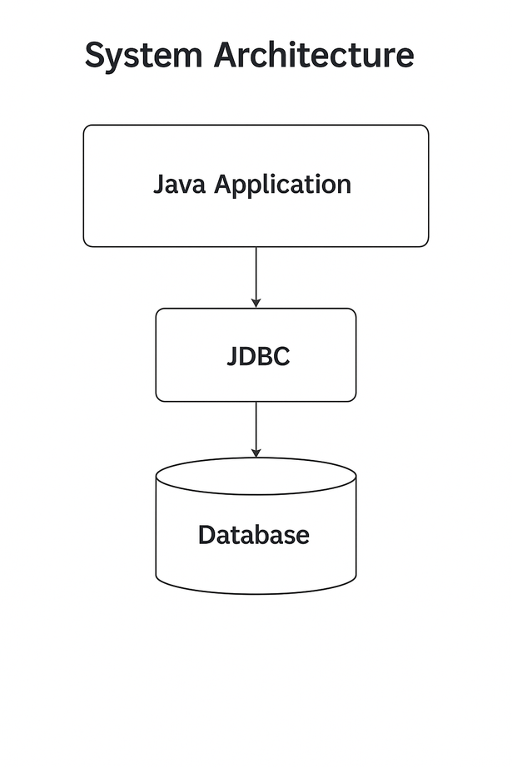
SYSTEM ARCHITECTURE

Slide 5
FEATURES
Add/View/Delete/Search Books
Register/Delete Members
Issue & Return Books
Maintain Borrow History

Slide 6

CODE STRUCTURE
LibraryManagement/
├── lib/
├── src/
│ ├── db/ → DBConnection.java
│ ├── manager/ → LibraryManager.java
└── Main.java
DBConnection.java: Connects to MySQL
LibraryManager.java: Core logic
Main.java: Menu & user interaction

Slide 7
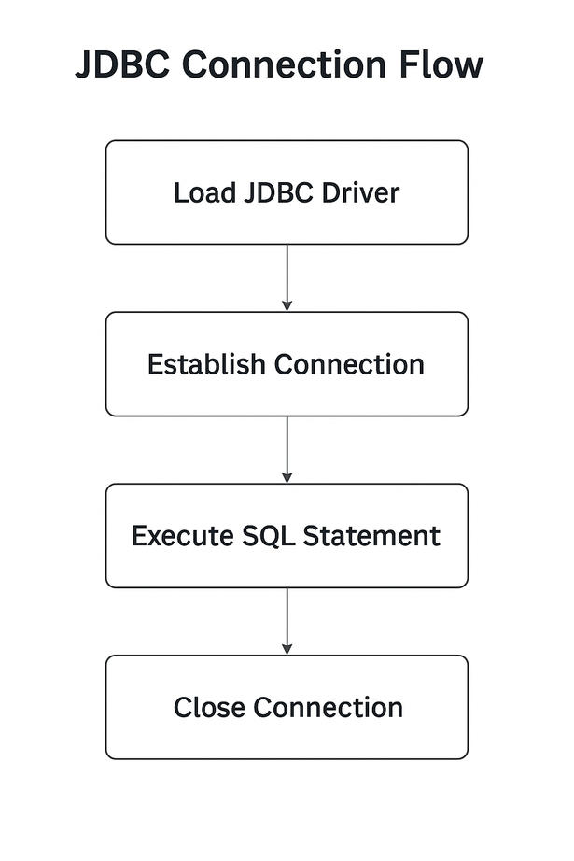
JDBC CONNECTION FLOW

Slide 8
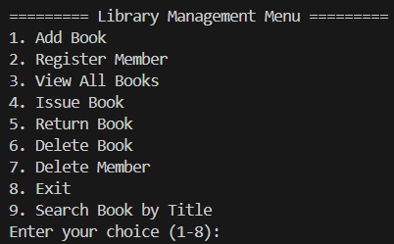
SAMPLE MENU (MAIN.JAVA)

Slide 9
CONCLUSION
Achieved full CRUD + transaction management using Java + MySQL.
Learned JDBC integration, SQL design, and console-based logic.
Can be extended into GUI/Web in the future

Slide 10
THANK
YOU!

